Slide 1


CRE133: GAME DESIGN THEORY & PRACTICE
GAME DESIGN PRESENTATION
Coursework – Part 1
Jacob Mckirgan
Notes:
You are welcome to use a themed template.

Slide 2

Katze’s 9th Symphony
A cat named Mary is the loyal fictional cat of the famed composer, Ludwig Van Beethoven. Whilst on the night that Ludwig writes his 5th symphony, Mary sleeps soundly at his feet, dreaming of writing her own music as she loved listening to her master write, hum and practice his songs.
The main genre of my game combines a 2D platformer that combines gothic/horror styled themes as well as a rhythmic components to the gameplay through the use of timed jumps onto platforms through the music notes that are in time to Beethoven’s 5th symphony
The main platforms that the game would be released to would be firstly Steam and perhaps Itch.io and game jolt with possible console editions in due time.

Slide 3
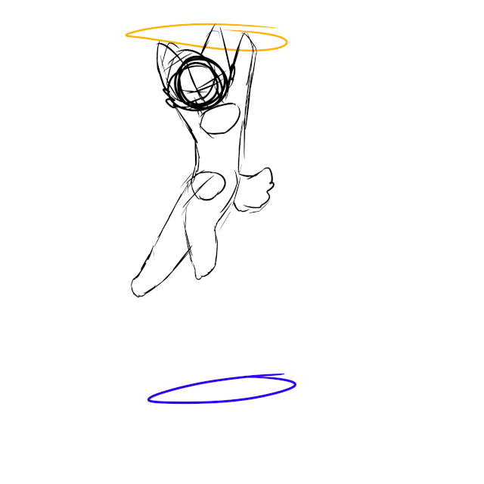
[RESEARCH-MECHANIC 1: PHYSICS]
Game physics Is a crucial mechanic in a plethora of modern and retro games, Mario can jump but he must come down to earth but there is also game features with twists that rule such as the propellor mushroom.
Game physics can involve various features that can be incorporated into games such as falling because of gravity or flight simulators with their factors such as wind and altitude. Game gravity is one of the most popular game mechanics that is manipulated in a wide variety of different games.
Another popular physics mechanic involves time manipulation especially with the popular FPS game Superhot where time in the game only moves when the player either moves the character or looks around the environment.
Game physics play a crucial part in platformer games as the player may be put in a position where they have to make precise jumps or falls making use of the physics of the game to help them progress.

Slide 4
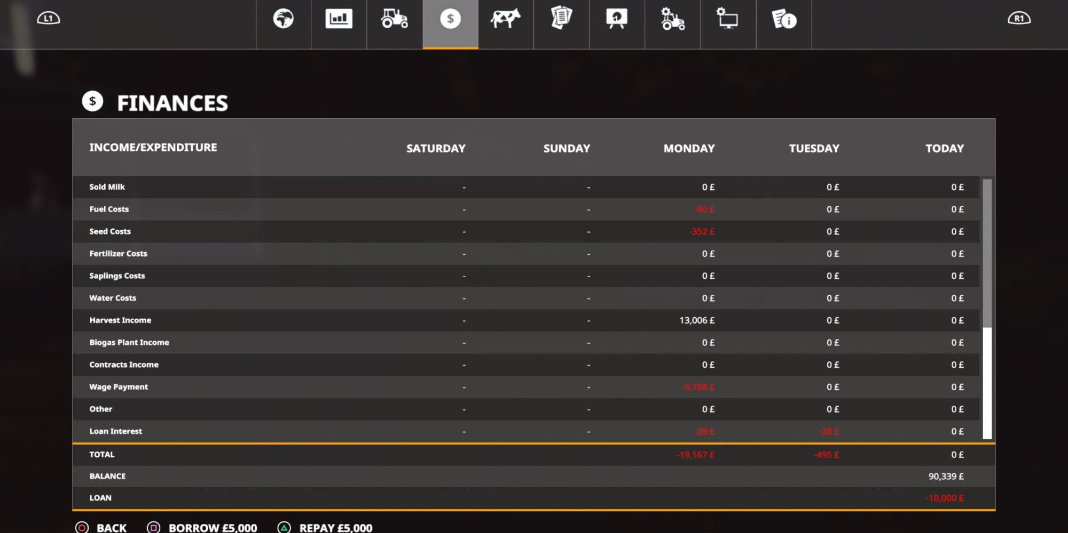
[RESEARCH-MECHANIC 2: ECONOMY]
Economy mechanics are quite a fun tool that can be implemented into games to provide the player to calculate and think logically whether its resources in Minecraft or money and tender in games such as Stardew Valley and even in GTA. Economy mechanics can range in learning curves in understanding how they work as money in Stardew could be considered easily understandable compared to market and inflation in Farming Simulator.
Economy mechanics require the player to resource manage and to think logically about decisions and whether it might hinder their resources. Economy mechanics doesn’t just contain money and resources it also describes ammo consumption in shooter games and how much ammo the player has in their gun. Doom does this very well with ammo for certain guns as pickups throughout the map which increases in density in rooms close to boss fights.

Slide 5
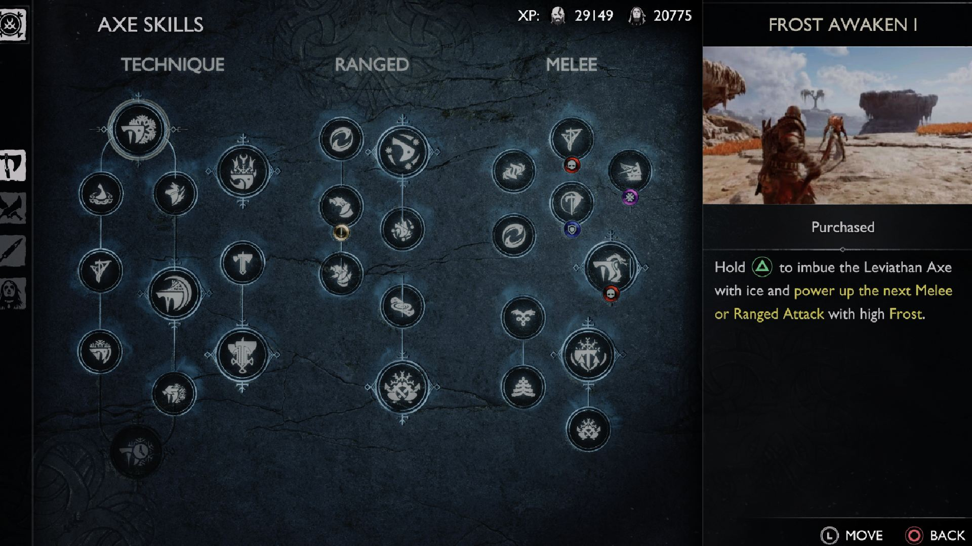
[RESEARCH-MECHANIC 3: PROGRESSION]
Progression mechanics have become quite a staple in modern generations of gaming, giving players a sense of achievement as they complete a quest, unlock new weapons or level up their character like evolution in the Pokémon games.
Progression game mechanics involve the player triggering certain events in the game which progress the player further whether its in the story of the game, a quest or upgrading their character through the use of skill trees like the ones found in modern games of assassins creed.
Progression game mechanics have become widely popular in recent years with most games especially in RPGs where the player can tailor their character in any way that they see fit to them which is achieved through skills trees where the player can adapt their player to their favorable situations.

Slide 6
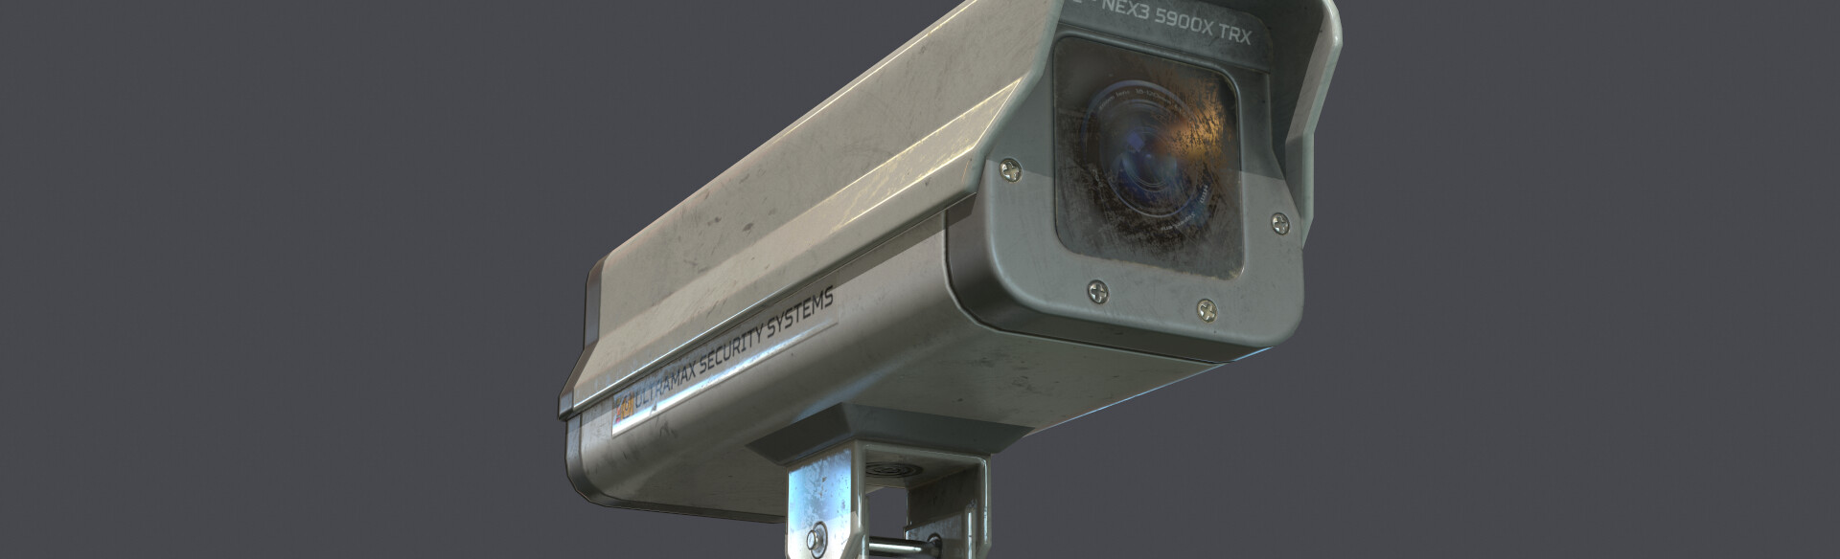
[RESEARCH-MECHANIC 4: TACTICAL]
Tactical mechanics are in a sense, mechanics that require the player to think logically and plan out certain movements being aware of factors that may affect them. They can require problem solving and thinking ahead for the player to plan out a scenario for the best outcome.
Tactical games can also involve the player using initiative and thinking on their toes in perhaps situations where enemies have a line of sight that the player must avoid to avoid being seen, this is used in heists in GTA V with security cameras and guards walking around with a line-of-sight area that the player must avoid.
Another example of tactical mechanics involve grid-based movement which is used mainly in conquest strategy games and as well in Baldur's Gate 3 with certain ranges of distance that a character to move to reach an enemy.

Slide 7
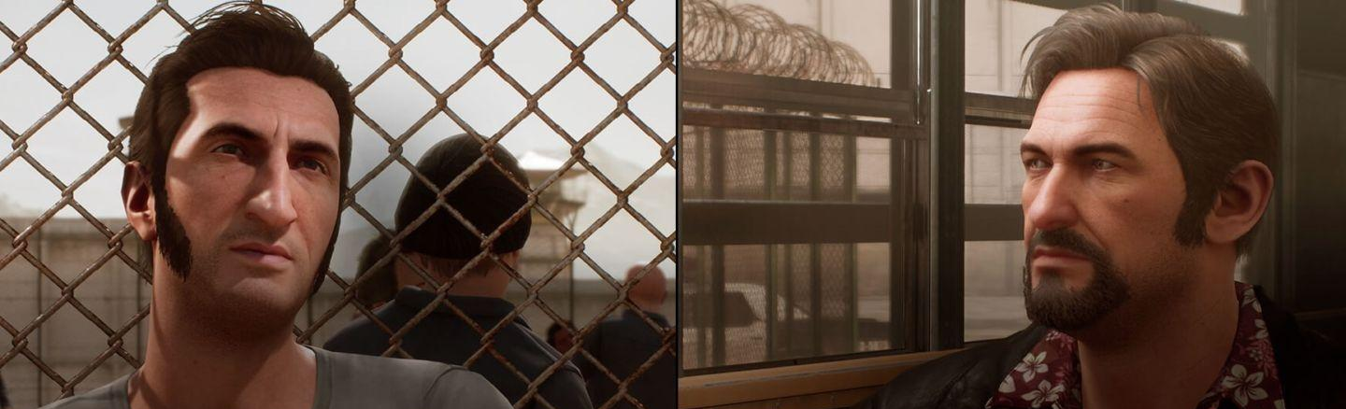
[RESEARCH-MECHANIC 5: SOCIAL]
Social game mechanics involves the player interacting with either NPCs or other players to accomplish a goal, team up to defeat a boss or trade items like the trading system in Pokémon games where only certain Pokémon can be caught through the use of trading.
Games like Roblox, VRChat and a great variety of Minecraft servers make great use of social mechanics through the use of competitions with mini-games on Minecraft servers like The Hive and Mineplex and also a large variety of games on Roblox involve competitions where players can race, battle or a variety of other challenges to test their skills.
A fantastic example of teamwork in gaming is a game called Heave Ho where players play as these creatures that are nothing more than a head with arms and their goal is to navigate through the level helping each other reach the goal by stringing themselves and swinging and climbing to the finish point.

Slide 8
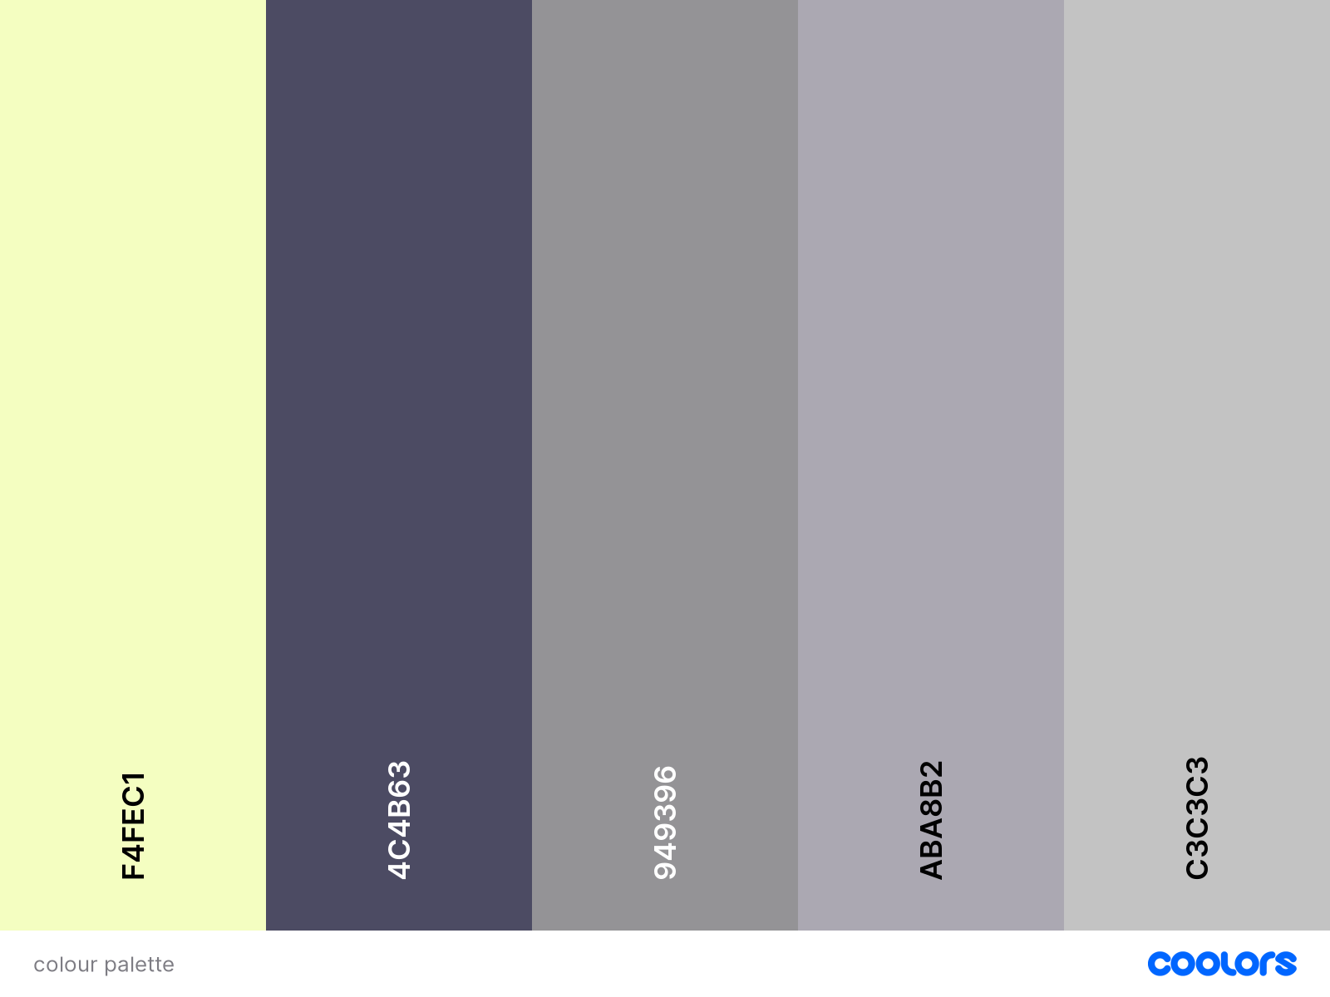
[GAME IDEA/THEME]
My personal game idea involves a cat named Mary is the loyal fictional cat of the famed composer, Ludwig Von Beethoven. Whilst on the night that Ludwig writes his 5th symphony, Mary sleeps soundly at his feet, dreaming of writing her own music as she loved listening to her master write, hum and practice his songs.
Within her dreams, she sees herself trapped in the pages of her master writing his 5th symphony and to try and escape she must climb and jump from the music notes to reach the top of the page however she must also fight off the spirits that are plaguing her master with his deteriorating health condition.
I believe that my game has a certain level of uniqueness to it as I've never found a game that is hugely like it in terms of theme and genre and general concept of the entire game.
The games' themes combines a depressing moody theme with the thunder and lightning in the background whilst the piano plays in the background and the spirits wail his 5th symphony in an unsettling tone. To the right of the text is the chosen games color palette
Notes:
In your own words
Tell us about your game idea?
What makes it so special, novel?
Describe the games' theme? Show us your inspiration? Colour palette’s etc

Slide 9
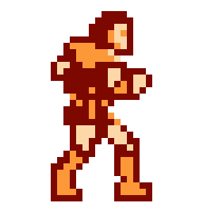
[CHOSEN GAME MECHANIC]
My chosen game mechanic for this coursework is gravity which is a physics type mechanic that is a huge staple and generally universally used mechanic in basically every game.
I chose the gravity physics mechanic as I am a huge lover of gravity in games and the ways it can be manipulated and changed to flow nicely with the gameplay. I feel like gravity mechanics flow with the game smoothly being a 2d platformer where the players main objective is to reach a platform and figure out how to get to the next.
I feel as if my chosen mechanic enhances and adds uniqueness to my gameplay through the use of how the gravity is used in the game. Mary, the cat will have to make precise jumps across the music notes which in turn will move around in a linear motion which requires precise jumps to reach the platforms taking inspiration from the difficult platformer, Castlevania.
Notes:
In your own words
What type of game mechanic is it? E.g., Progression, economy etc
Why did you choose it?
Describe how the mechanic enhances gameplay, contributes to player engagement, or adds uniqueness to the game.

Slide 10

[GAMEPLAY]
Example of note block changing direction
The gameplay asks of the player relative concentration and quick movements where maybe a single pixel could be the difference between life and death. The gameplay is designed in such a way where repetition and repeating the same moves many times will become muscle memory to the player as they traverse the music notes where they make a jump without even thinking of pressing the jump button.
The gameplay of this game is heavily inspired from a number of different platformers that I have grown to love over the years. The main games I took inspiration from for this game were Shovel Knight, Jump King and the retro Mario games and price of Persia.
On the right is a very basic animation which shows the notes movement where the grey parts are when the beat occurs where the notes inverts its path.
Notes:
Definition of Gameplay:
“Gameplay is a crucial element in any skill-and-action game. Everyone agrees that good gameplay is essential to the success of a game, and that gameplay has something to do with the quality of the player’s interaction with the game. Beyond that, nuances of meaning are as numerous as users of the phrase. I suggest that this elusive trait is derived from the combination of pace and cognitive effort required by the game”. - Chris Crawford

Slide 11
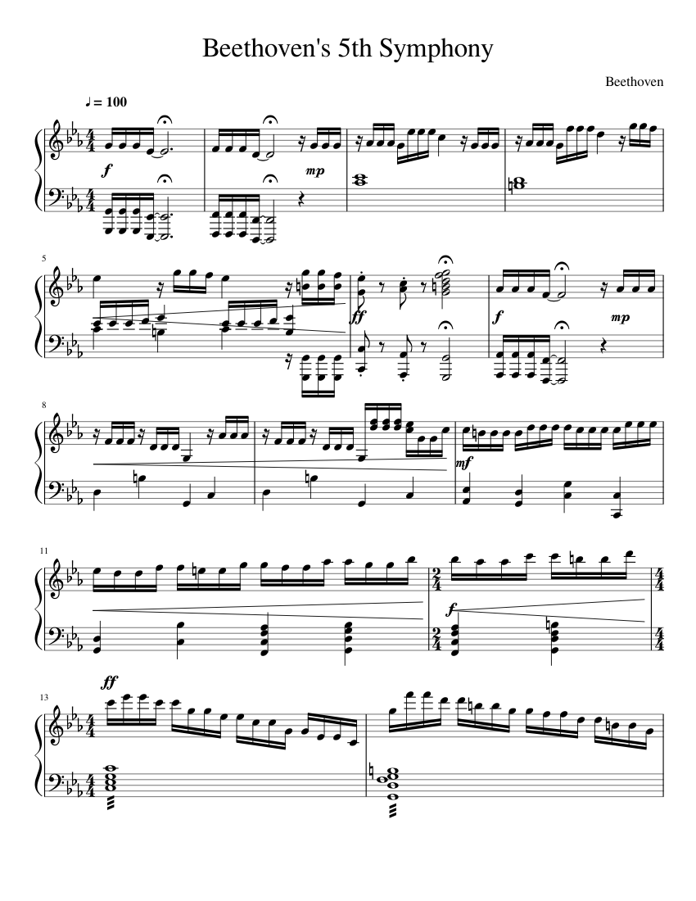
[LEVEL DESIGN]
The first level of the game begins with the cat falling asleep at her master’s feet. She then wakes up however she wakes up at the bottom of the page that her master is writing his 5th symphony on. She sees light towards the top of the page and nothing but abyss below her feet.
The first level involves the player controlling Mary to jump from the music notes of Beethoven’s 5th symphony to make her way up the page using precisely timed jumps as the music notes to tend to move in linear directions whether it be horizontally or vertically across the page and the player must time jumps right as each note will change direction on the beat to the music e.g., if a platform is moving left and there is a large beat in the music it will change and go the opposite direction.
Notes:
In your own words
Design one simple game level that works with your game idea and theme and. The level design must help demonstrate your chosen game mechanic.
What type of game mechanic is it? E.g., Progression, economy etc
Why did you choose it?
Describe how the mechanic enhances gameplay, contributes to player engagement, or adds uniqueness to the game.

Slide 12
[ART & SOUND]
Art: The main art of the game is done through the use of pixel art graphics using Aseprite that have an eerie and quite gothic renaissance theme to the whole art of the game and the gameplay with darker and more sinister and almost anxiety inducing colours that complements the sound and music.
For the colour scheme of the game I took inspiration from the internet creepy pasta, the backrooms where the colours are so basic and bland, that staring at them for too long drives a feeling of uncomfortableness in the player.
Sound: The sound of the game plays a massive role in the atmosphere and immersion of the game. The slight meows and purrs of the cat as she licks her paws if idle for too long. The breaths and moans of the spirits plaguing Beethoven with his illnesses as they hum his 5th symphony in a eerie and paranoid way. I feel like these eerie SFX really complement the art style and colour scheme which adds to the immersion of the gameplay.
All of this whilst a very famous piece of traditional music plays softly and calmly in the background.
Notes:
In your game idea, it's essential to vividly describe the art and sound aspects to bring your vision to life. Art and sound are integral components of the gaming experience that greatly influence player immersion and enjoyment. Here's how to describe them effectively.
Inspiration and References: If you drew inspiration from specific artists, games, films, or soundtracks, mention them and explain how they influenced your choices for art and sound.

Slide 13
Bibliography
https://ih1.redbubble.net/image.2326168205.1618/fposter,small,wall_texture,product,750x1000.jpg
https://pa1.narvii.com/6722/d3f95c0e06612862f2b7c0341678f9a6469c0716_hq.gif
https://guides.gamepressure.com/farming-simulator-19/gfx/word/124826484.jpg
https://www.theloadout.com/wp-content/sites/theloadout/2022/11/god-of-war-ragnarok-skills-trees-5.jpg

Slide 14
Bibliography 2
https://vignette.wikia.nocookie.net/aewvs-rp/images/c/c5/Pixelcloud-studio-screenshot027.jpg/revision/latest?cb=20200825054328
https://cdn.wccftech.com/wp-content/uploads/2018/02/awayout_split-2060x1056.jpg
Colour Palette made using coolors website
https://th.bing.com/th/id/R.651d880dbba5defae30eb0b5d37218b2?rik=afLtox6m5X1cLw&riu=http%3a%2f%2fpa1.narvii.com%2f6931%2fccf4e50f155b7da20d601918ccd455604a6c0dcdr1-256-256_00.gif&ehk=HDDgvNAyc7yZi%2bIiNhJAlFWFvTdUH3FQ%2becg%2bTMGDUo%3d&risl=&pid=ImgRaw&r=0
https://musescore.com/static/musescore/scoredata/gen/1/5/5/1780551/d34fe9a1749aa8a8cbe53ba4b83507a07ef3cd09/score_0.png?revision=1455989875&no-cache=1531731676

